Slide 1

Predictive Learning from Data
LECTURE SET 5
Nonlinear Optimization Strategies
Electrical and Computer Engineering

Slide 2
OUTLINE
Objectives
- describe common optimization strategies used for nonlinear (adaptive) learning methods
- introduce terminology
- comment on implementation of model complexity control
Nonlinear Optimization in learning
Optimization basics (Appendix A)
Stochastic approximation (gradient descent)
Iterative methods
Greedy optimization
Summary and discussion

Slide 3
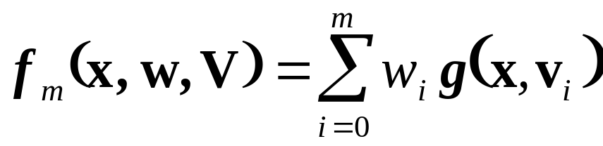
Optimization in predictive learning
Recall implementation of SRM:
- fix complexity (VC-dimension)
- minimize empirical risk
Two related issues:
- parameterization (of possible models)
- optimization method
Many learning methods use dictionary parameterization
Optimization methods vary

Slide 4
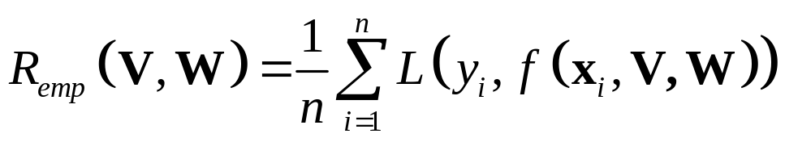
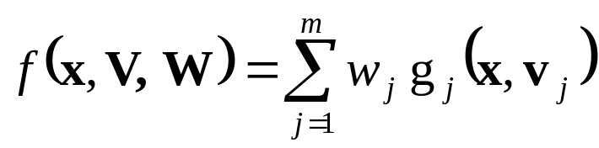

Nonlinear Optimization
The ERM approach
where the model
Two factors contributing to nonlinear optimization
nonlinear basis functions
non-convex loss function L
Examples
convex loss: squared error, least-modulus
non-convex loss: 0/1 loss for classification

Slide 5
Unconstrained Minimization
ERM or SRM (with squared loss) lead to unconstrained convex minimization
Minimization of a real-valued function of many input variables
→ Optimization theory
We discuss only popular optimization strategies developed in statistics, machine learning and neural networks
These optimization methods have been introduced in various fields and usually use specialized terminology

Slide 6
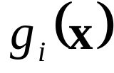


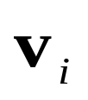
Dictionary representation
Two possibilities
Linear (non-adaptive) methods
~ predetermined (fixed) basis functions
→ only parameters have to be estimated
via standard optimization methods (linear least squares)
Examples: linear regression, polynomial regression
linear classifiers, quadratic classifiers
Nonlinear (adaptive) methods
~ basis functions depend on the training data
Possibilities : nonlinear b.f. (in parameters )
feature selection (i.e. wavelet denoising), etc.

Slide 7
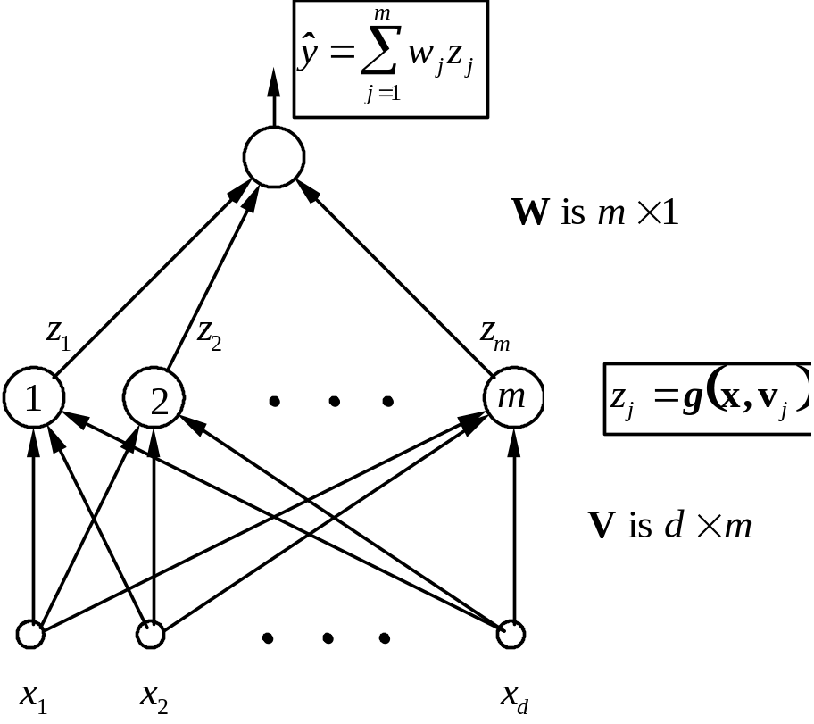
Nonlinear Parameterization: Neural Networks
MLP or RBF networks
- dimensionality reduction
- universal approximation property
- possibly multiple ‘hidden layers’ – aka “Deep Learning”

Slide 8
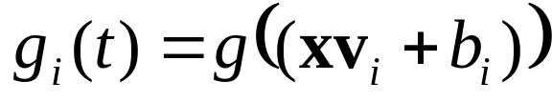
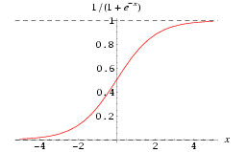
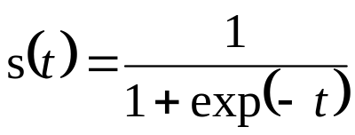
Multilayer Perceptron (MLP) network
Basis functions of the form
i.e. sigmoid aka logistic function
- commonly used in artificial neural networks
- combination of sigmoids ~ universal approximator

Slide 9
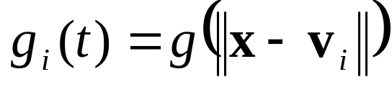
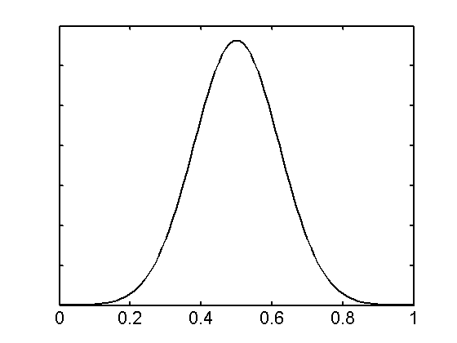
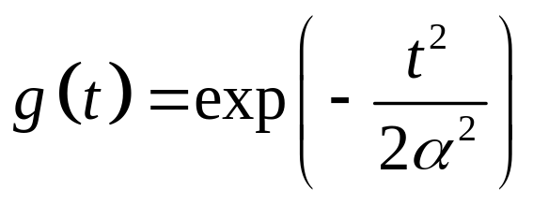
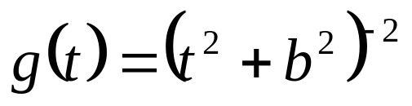

RBF Networks
Basis functions of the form
i.e. Radial Basis Function(RBF)
- RBF adaptive parameters: center, width
- commonly used in artificial neural networks
- combination of RBF’s ~ universal approximator

Slide 10
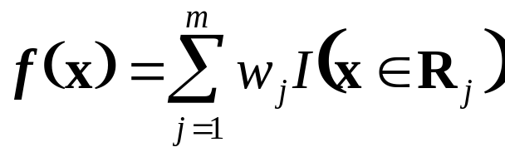
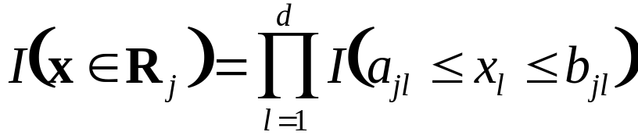
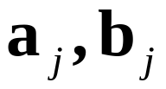

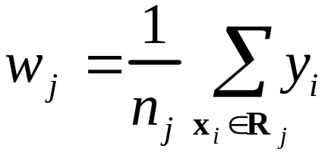
Piecewise-constant Regression (CART)
Adaptive Partitioning (CART)
each b.f. is a rectangular region in x-space
Each b.f. depends on 2d parameters
Since the regions are disjoint, parameters w
can be easily estimated (for regression) as:
Estimating b.f.’s ~ adaptive partitioning of x-space

Slide 11
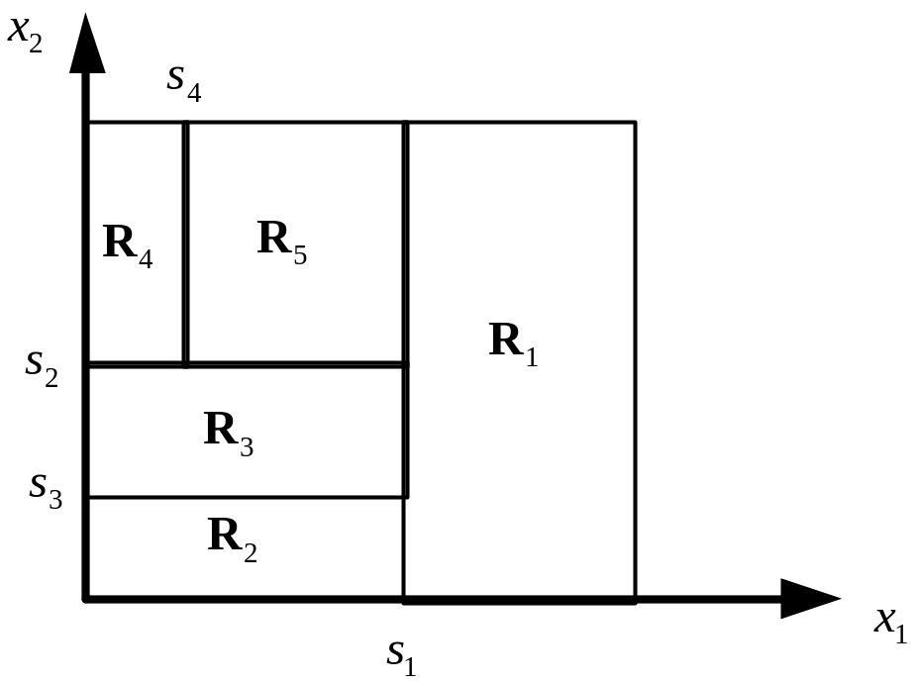
Example of CART Partitioning
CART Partitioning in 2D space
- each region ~ basis function
- piecewise-constant estimate of y (in each region)
- number of regions m ~ model complexity

Slide 12
OUTLINE
Objectives
Nonlinear Optimization in learning
Optimization basics (Appendix A)
Stochastic approximation aka gradient descent
Iterative methods
Greedy optimization
Summary and discussion

Slide 13
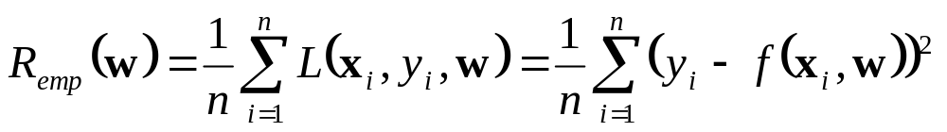
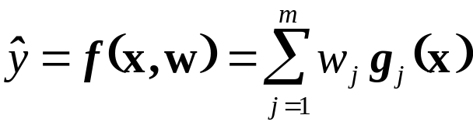
Sequential estimation of model parameters
Batch vs on-line (iterative) learning
- Algorithmic (statistical) approaches ~ batch
- Neural-network inspired methods ~ on-line
BUT the only difference is on the implementation level (so both types of methods should yield similar generalization)
Recall ERM inductive principle (for regression):
Assume dictionary parameterization with fixed basis fcts

Slide 14

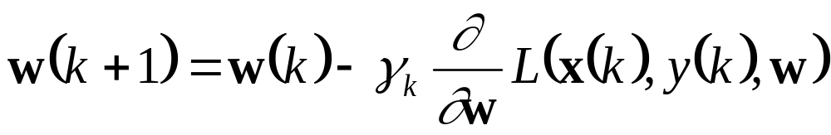
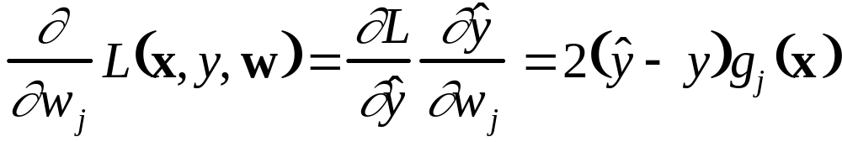
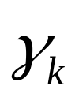
Sequential (on-line) least squares minimization
Training pairs presented sequentially
On-line update equations for minimizing empirical risk (MSE) wrt parameters w are:
(gradient descent learning)
where the gradient is computed via the chain rule:
the learning rate is a small positive value (decreasing with k)

Slide 15
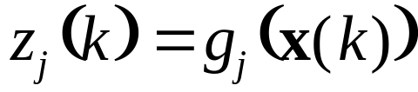

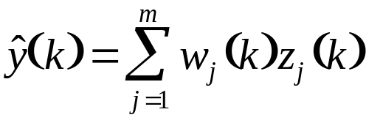

On-line least-squares minimization algorithm
Known as delta-rule (Widrow and Hoff, 1960):
Given initial parameter estimates w(0), update parameters during each presentation of k-th training sample x(k),y(k)
Step 1: forward pass computation
- estimated output
Step 2: backward pass computation
- error term (delta)

Slide 16
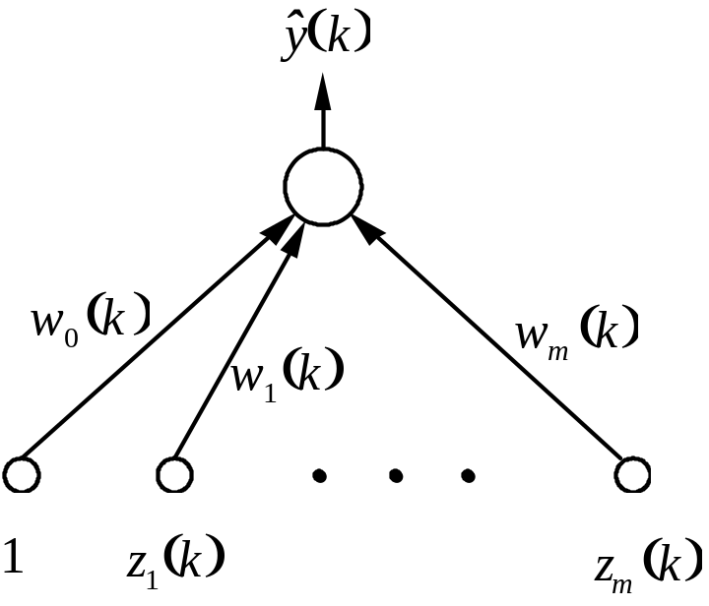
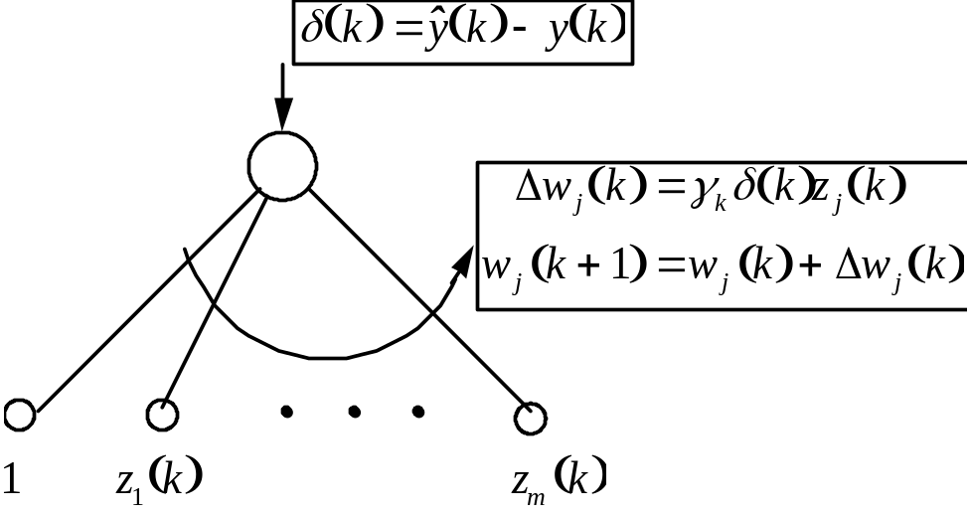
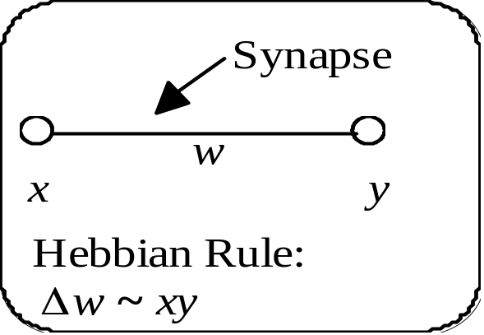
Neural network interpretation of delta rule
Forward pass Backward pass
“Biological learning”
- parallel+ distributed comp.
- can be extended to
multiple-layer networks

Slide 17
Backpropagation Training for MLP Networks
MLP networks
Delta rule can be extended to multi-layer networks, aka “backpropagation” training
- see derivation in the textbook

Slide 18
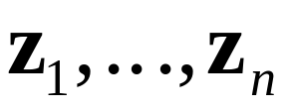
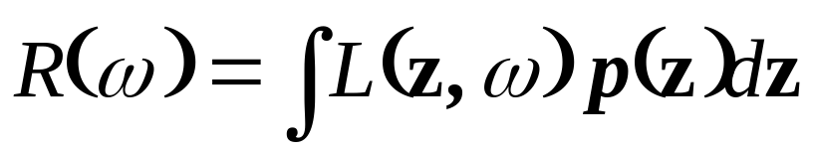
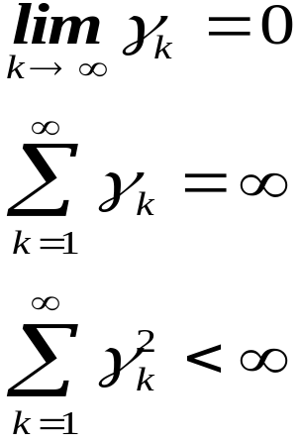
Theoretical basis for on-line learning
Standard inductive learning: given training data find the model providing min of prediction risk
Stochastic Approximation guarantees minimization of risk (asymptotically):
under general conditions
on the learning rate:

Slide 19
Caveats for nonlinear optimization
Multiple Local Minima: always possible.
Slow convergence: if learning rate is too small
Slow/poor convergence: if learning rate is too large (for some error surfaces)
Hence many heuristic modifications of basic gradient descent learning (TBD later)

Slide 20
Practical issues for on-line learning
Given finite training set (n samples):
this set is presented sequentially to a learning algorithm many times. Each presentation of n samples is called an epoch, and the process of repeated presentations is called recycling (of training data)
Learning rate schedule: initially set large, then slowly decreasing with k (iteration number). Typically ’good’ learning rate schedules are data-dependent.
Stopping conditions:
(1) monitor the gradient (i.e., stop when the gradient falls below some small threshold)
(2) early stopping can be used for complexity control

Slide 21
OUTLINE
Objectives
Nonlinear Optimization in learning
Optimization basics (Appendix A)
Stochastic approximation aka gradient descent methods
Iterative methods
Greedy optimization
Summary and discussion

Slide 22
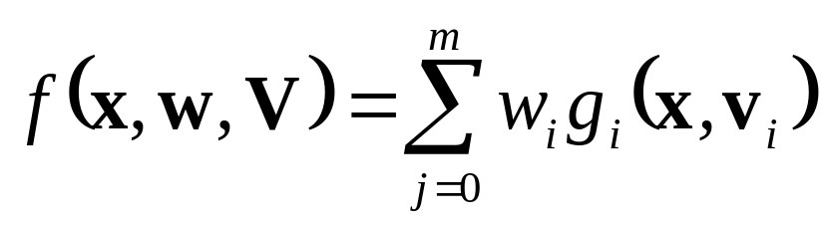

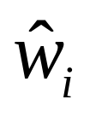
Dictionary representation with fixed m :
Iterative strategy for ERM (nonlinear optimization)
Step 1: for current estimates of update
Step 2: for current estimates of update
Iterate Steps (1) and (2) above
Note: - this idea can be implemented for different problems:
e.g., unsupervised learning, supervised learning
Specific update rules depend on the type of problem & loss fct.

Slide 23
Iterative Methods
Expectation-Maximization (EM) developed/used in statistics
Clustering and Vector Quantization in neural networks and signal processing
Both originally proposed and commonly used for unsupervised learning / density estimation problems
Note: for unsupervised learning the goal is not prediction but rather descriptive modeling via data reduction or dimensionality reduction

Slide 24
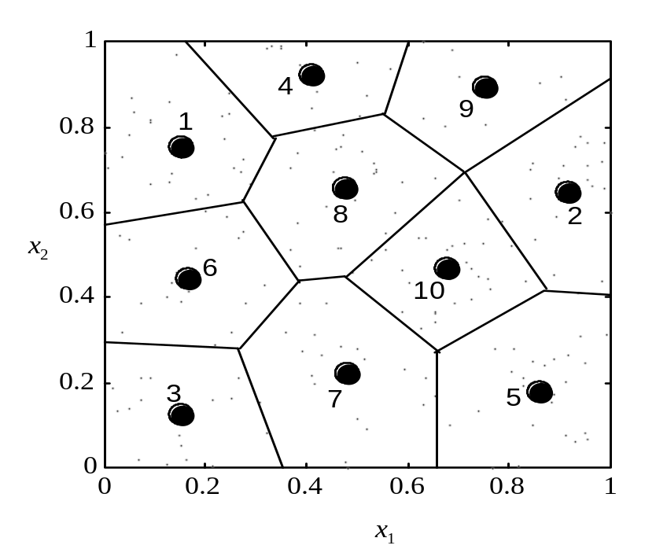
Vector Quantization and Clustering
Two complementary goals of VQ:
1. partition the input space into disjoint regions
2. find positions of units (coordinates of prototypes)
Note: optimal partitioning into regions (for given units) is according to nearest-neighbor rule (~ the Voronoi regions)

Slide 25




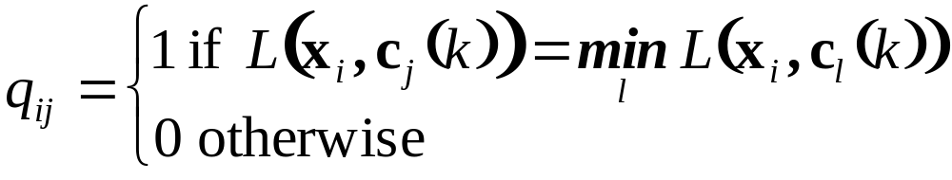
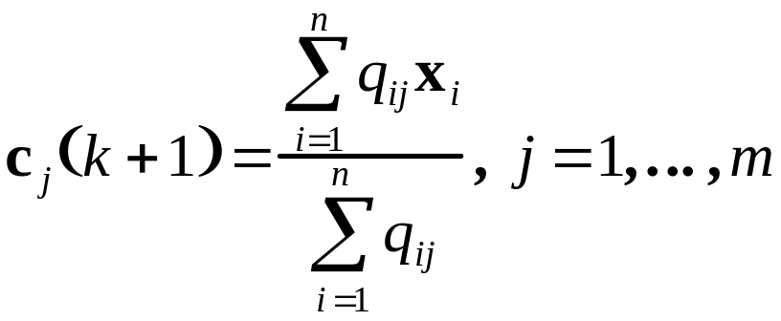
GLA (Batch version)
Given data points , loss function L (i.e., squared loss) and initial centers
Iterate the following two steps
1. Partition the data (assign sample to unit j ) using the nearest neighbor rule. Partitioning matrix Q:
2. Update unit coordinates as centroids of the data:

Slide 26
Statistical Interpretation of GLA
Iterate the following two steps
1. Partition the data (assign sample to unit j ) using the nearest neighbor rule. Partitioning matrix Q:
~ Projection of the data onto model space (units)
(aka Maximization Step)
2. Update unit coordinates as centroids of the data:
~ Conditional expectation (averaging, smoothing)
‘conditional’ upon results of partitioning step (1)

Slide 27
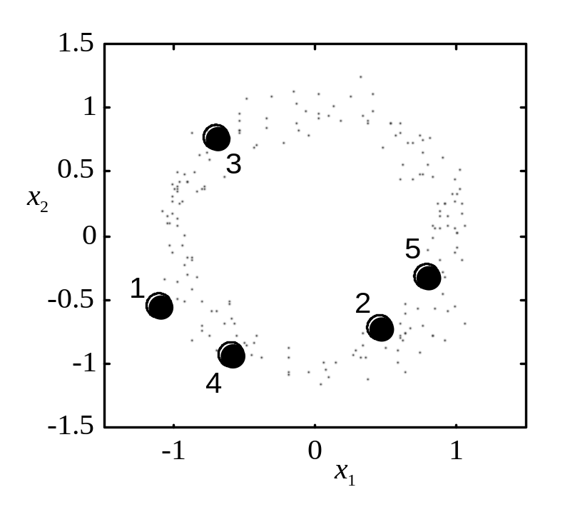
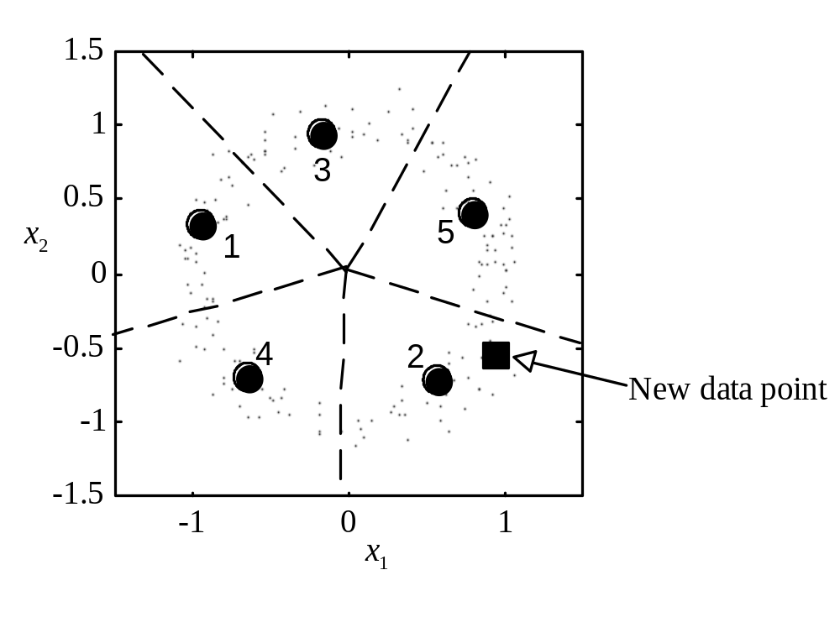
GLA Example 1
Modeling doughnut distribution using 5 units
(a) initialization (b) final position (of units)

Slide 28
EM Method
Expectation-Maximization (EM) for density estimation (from statistics)
Unknown distribution is modeled as a mixture of several density components (e.g. normal distributions)
Need to estimate (from training data):
- parameters of each component
- weights in a mixture
→ Iterative EM algorithm (see textbook)

Slide 29
OUTLINE
Objectives
Nonlinear Optimization in learning
Optimization basics (Appendix A)
Stochastic approximation (gradient descent)
Iterative methods
Greedy optimization
Summary and discussion

Slide 30
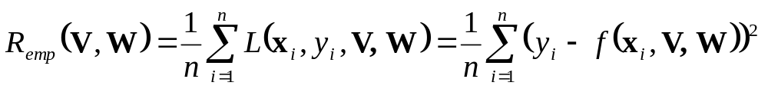
Greedy Optimization Methods
Minimization of empirical risk (regression problems)
where the model
Greedy Optimization Strategy
basis functions are estimated sequentially, one at a time,
i.e., the training data is represented as
structure (model fit) + noise (residual):
(1) DATA = (model) FIT 1 + RESIDUAL 1
(2) RESIDUAL 1 = FIT 2 + RESIDUAL 2
and so on. The final model for the data will be
MODEL = FIT 1 + FIT 2 + ....
Advantages: computational speed, interpretability

Slide 31
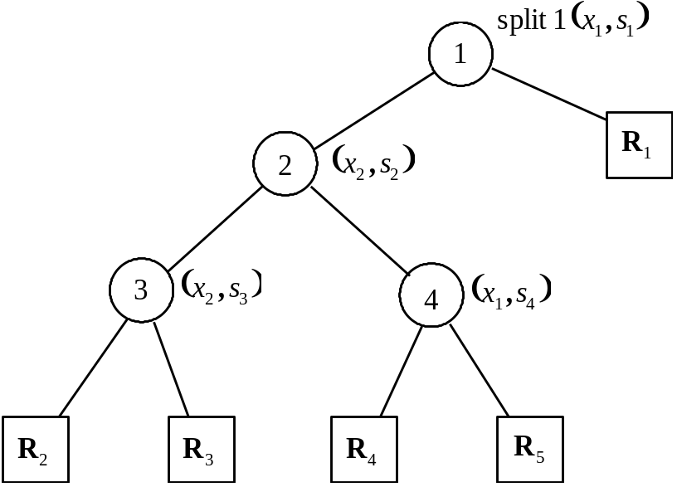
Regression Trees (CART)
Minimization of empirical risk (squared error) via partitioning of the input space into regions
Example of CART partitioning for a function of 2 inputs

Slide 32



Growing CART tree
Recursive partitioning for estimating regions (via binary splitting)
Initial Model ~ Region (the whole input domain) is divided into two regions and
A split is defined by one of the inputs(k) and split point s
Optimal values of (k, s) chosen so that splitting a region into two daughter regions minimizes empirical risk
Issues:
- efficient implementation (selection of opt. split)
- optimal tree size ~ model selection(complexity control)
Advantages and limitations

Slide 33
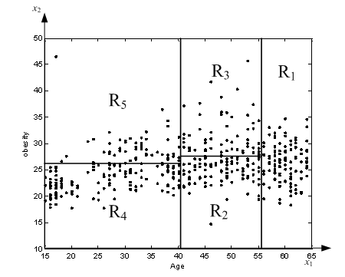
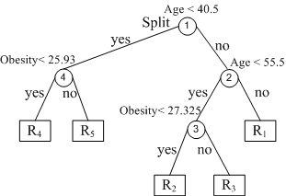
CART Example
CART regression model for estimating Systolic Blood Pressure (SBP) as a function of Age and Obesity in a population of males in S. Africa

Slide 34
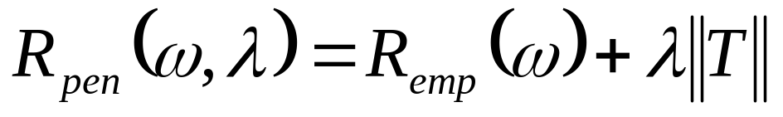
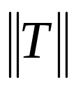

CART model selection
Model selection strategy
(1) Grow a large tree (subject to min leaf node size)
(2) Tree pruning by selectively merging tree nodes
The final model ~ minimizes penalized risk
where empirical risk ~ MSE
number of leaf nodes ~
regularization parameter ~
Note: larger → smaller trees
In practice: often user-defined (splitmin in Matlab)

Slide 35

Pitfalls of greedy optimization
Greedy binary splitting strategy may yield:
- sub-optimal solutions (regions )
- solutions very sensitive to random samples (especially with correlated input variables)
Counterexample for CART:
estimate function f(a,b,c):
Which variable for the first split ?
- Choose a → 4 errors
- Choose c → no errors
(in the final two-level tree model)
y | a | b | c
0 0 1 1 1 1 0 0 | 0 1 0 1 0 1 0 1 | 0 0 0 0 1 1 1 1 | 0 0 1 1 0 0 1 1

Slide 36
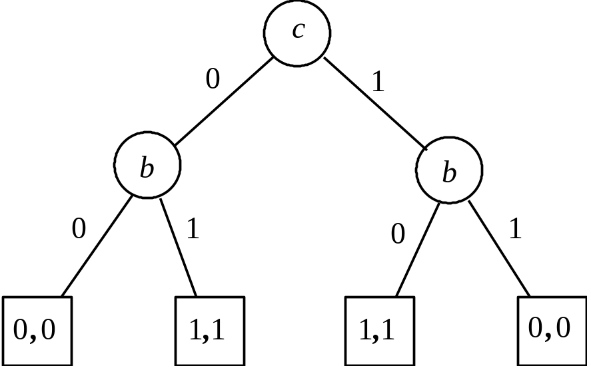
Optimal binary tree (for this data set)
Counter example (cont’d)

Slide 37
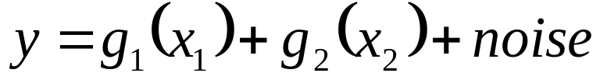
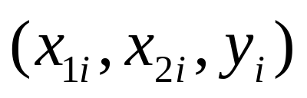
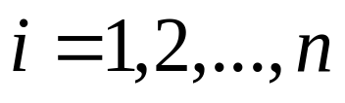
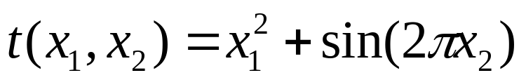
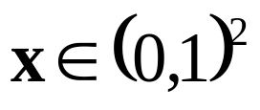





Backfitting Algorithm
Consider regression estimation of a function of two variables of the form
from training data
For example
Backfitting method: (1) estimate for fixed
(2) estimate for fixed
iterate above two steps
Estimation via minimization of empirical risk

Slide 38






Backfitting Algorithm(cont’d)
Estimation of via minimization of MSE
This is a univariate regression problem of estimating from n data points
where
Can be estimated by smoothing (kNN regression)
Estimation of (second iteration) proceeds in a similar manner, via minimization of
where
Backfitting ~gradient descent in the function space

Slide 39


Projection Pursuit regression
Projection Pursuit is an additive model:
where basis functions are univariate functions (of projections)
Regression model is a sum of ridge basis functions that are estimated iteratively via backfitting

Slide 40






Sum of two ridge functions for PPR

Slide 41


Sum of two ridge functions for PPR

Slide 42


Projection Pursuit regression
Projection Pursuit is an additive model:
where basis functions are univariate functions (of projections)
Backfitting algorithm is used to estimate iteratively
(a) basis functions (parameters ) via scatterplot smoothing
(b) projection parameters (via gradient descent)

Slide 43
OUTLINE
Objectives
Nonlinear Optimization in learning
Optimization basics (Appendix A)
Stochastic approximation aka gradient descent methods
Iterative methods
Greedy optimization
Summary and discussion

Slide 44
Summary
Different interpretation of optimization
Consider dictionary parameterization
VC-theory: implementation of SRM
Gradient descent + iterative optimization
- SRM structure is specified a priori
- selection of m is separate from ERM
Greedy optimization strategy
- no a priori specification of a structure
- model selection is a part of optimization

Slide 45
Summary (cont’d)
Interpretation of greedy optimization
Statistical strategy for iterative data fitting
(1) Data = (model) Fit1 + Residual_1
(2) Residual_1 = (model) Fit2 + Residual_2
………..
Model = Fit1 + Fit2 + …
This has superficial similarity to SRM

